Slide 1
SIAPWS Annual Account 2019 and SIAPWS Budget 2020

Slide 2
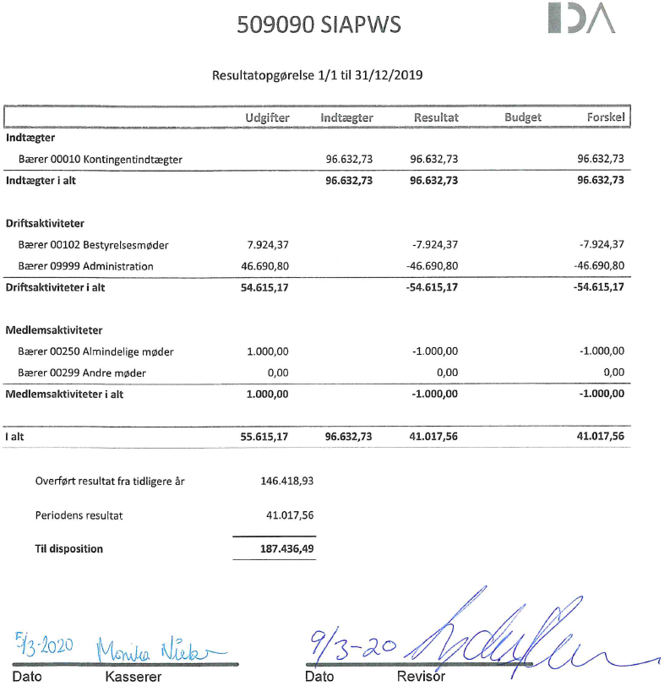
SIAPWS Annual Accounts 2019

Slide 3
SIAPWS Annual Accounts 2019
Comment: SIAPWS-DK payment of DKK 32.000/4.284 EUR is missing. Will be corrected in the 2020 account.

Slide 4
SIAPWS Budget 2020

